Slide 1
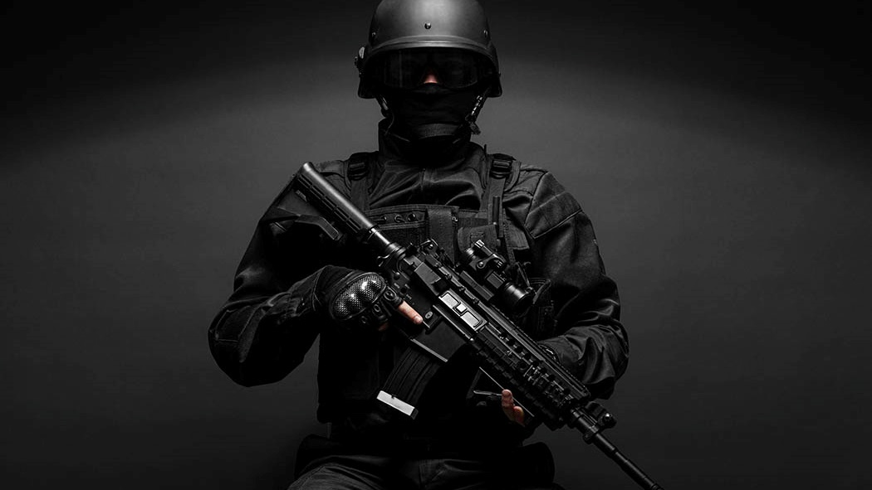
Autonomous Weapons
System
BY Nancy/Maaz/Samson

Slide 2
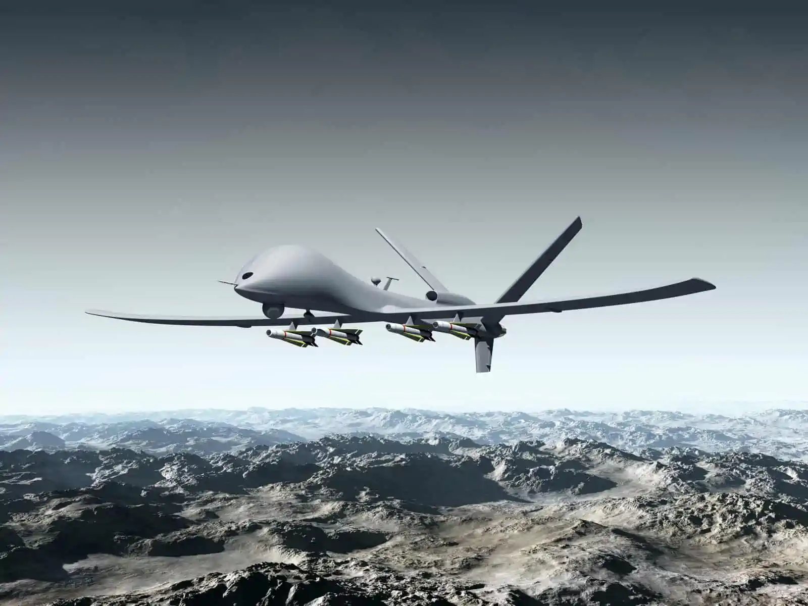
Introduction

Slide 3
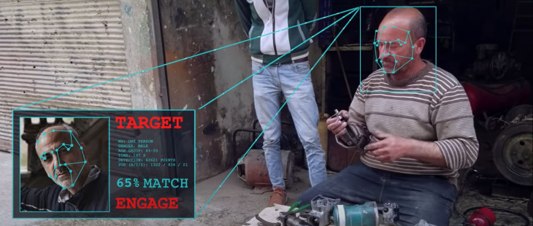
Introduction
Definition
Autonomous weapon systems are any weapons that select and apply force to targets without human intervention. --- ICRC
Principles
Sensors detect in the environment
Match: Target Profile.
Trigger: Sensors and Software.
Support
Ban
Notes:
A person activates an autonomous weapon, but they do not know specifically who or what it will strike, nor precisely where and/or when that strike will occur.
https://www.icrc.org/en/document/what-you-need-know-about-autonomous-weapons

Slide 4
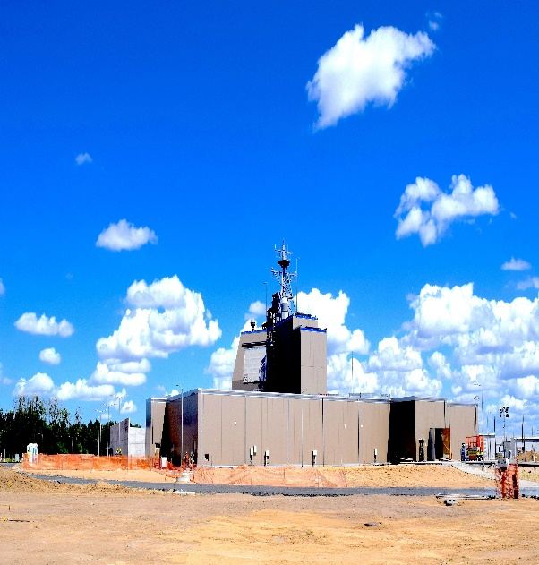
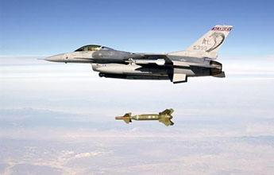
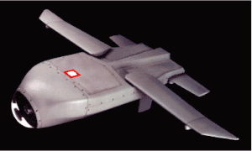
Examples
Human-Supervised
Autonomous Weapons
Semi-Autonomous Weapons
Human in the loop
Autonomous Weapons
Human out of the loop
A weapon system with the characteristics of an autonomous weapon system, but with the ability for human operators to monitor the weapon system’s performance and intervene to halt its operation, if necessary.
A weapon system that incorporates autonomy into one or more targeting functions and once activated, is intended to only engage individual targets or specific groups of target that a human has decided are to be engaged.
A weapon system that, once activated, is intended to select and engage targets where a human has not decided those specific targets are to be engaged.
Notes:
Ethical-Autonomy-Working-Paper_021015_v02.pdf (s3.us-east-1.amazonaws.com)
Human: U.S. ship-based Aegis and the land-based Patriot systems
Semi: Guided munitions
Auto: LOCAAS(U.S. low-cost autonomous attack system)

Slide 5
Marcus and Davis

Slide 6
Marcus & Davis
3
2
1
How general is the result?
Is there a demo where I can try it out?
What AI system do?
Highly controversial and regulated area, and such technology is not readily available for public use or demonstration.
Videos & Pictures
Depends on various factors.
Accuracy of sensors & algorithms used.
Environment.
complexity of task.
The intended outcome of an attack against AWS is to cause destruction, regardless of the target.
Notes:
Pros and Cons of Autonomous Weapons Systems (army.mil)

Slide 7
Marcus & Davis
6
5
4
How far does succeeding at that task take us towards genuine AI?
How robust is the system? Could it work just as well with other data sets, without massive amounts of retraining?
If it is alleged it is better than humans, which humans, and how much better?
It is better than the military personel
no human casualties
cheaper
It does not contribute towards genuine AI.
Nobody wants an AI that kills in their daily life
high performance: it can kill any target in any condition
unreliable: it has record of friendly fire
Notes:
it costs the Pentagon about $850,000 per year for each soldier in Afghanistan. Contrarily, a small rover equipped with weapons costs roughly $230,000
Genuine AI has the potential to perform a wide range of tasks and to exhibit human-like intelligence in multiple domains; narrow AI, is designed to perform specific, well-defined tasks, and does not possess the general intelligence in other areas
furthermore, genuine AI is thought to be assisting human in daily lives
2003 Iraq, automous missile deployed by the US targetted a British jet and killing 2 pilots and then two weeks later killed a U.S. Naval F18 pilot

Slide 8
Kapoor and Narayan

Slide 9
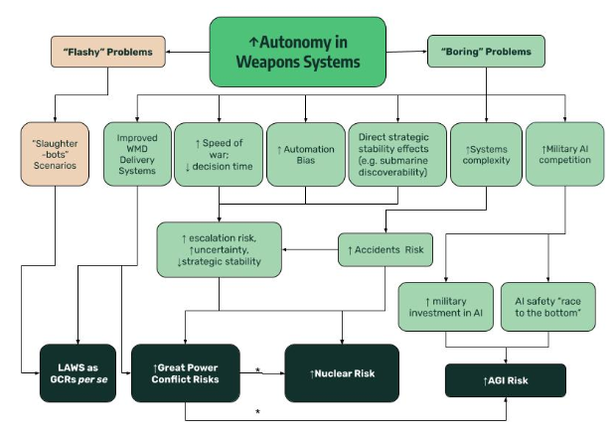
Kapoor & Narayan
System Complexity
Number 16: Downplaying Human Labor
Automation Bias
Number 3: Comparison with Human Intelligence
Number 13: No Discussion of Potential Limitations
Autonomous Weapon Systems/Military AI Cause Area Report - Google Docs

Slide 10
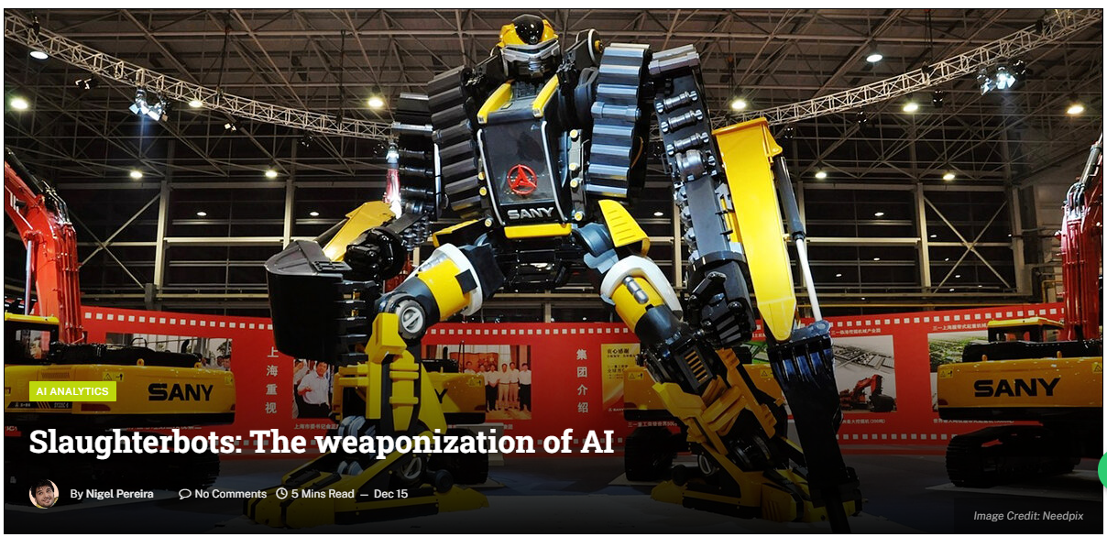
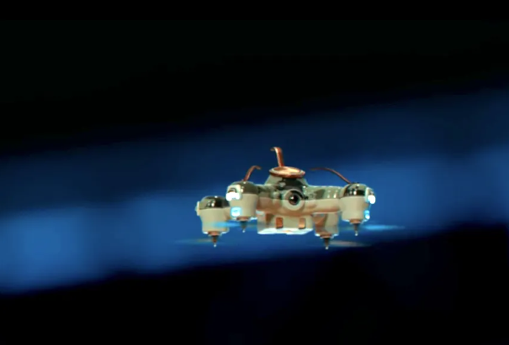
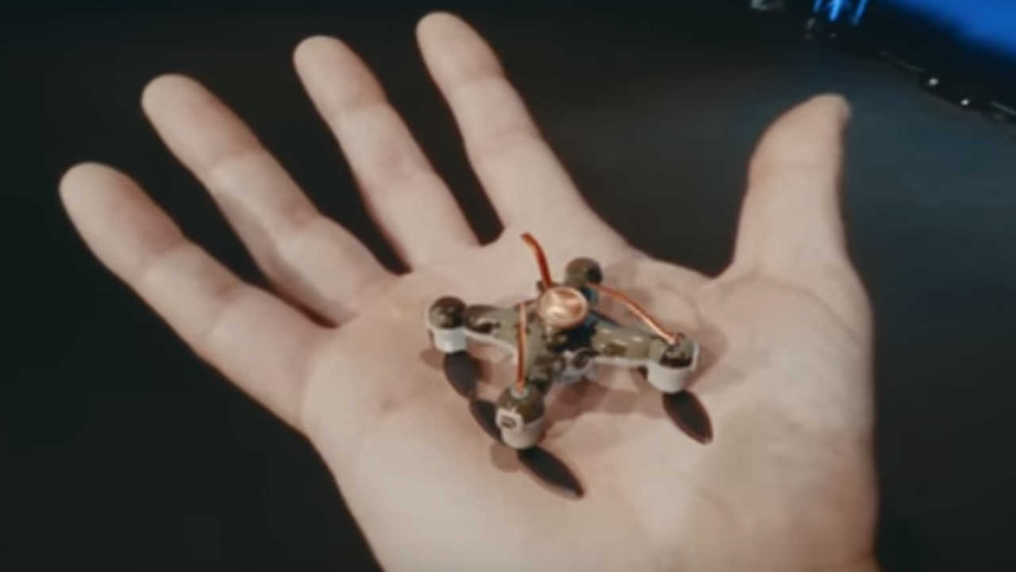
Kapoor & Narayan
Slaughterbots
Number 2: Suggestive Imagery
Number 13: No Discussion of Potential Limitations
“One of the main arguments on the ICRC’s website against the use of killer robots is that while AI may excel at facial recognition and targeting, it can never fully comprehend the value of human life.”
Slaughterbots: The weaponization of AI - Sify

Slide 11
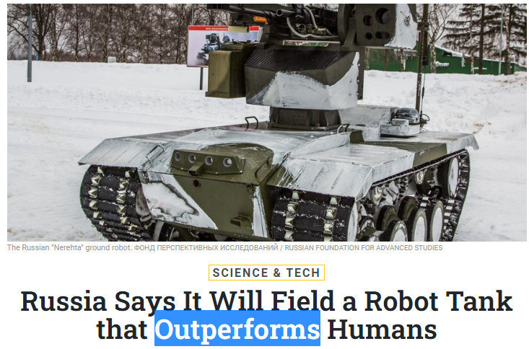
Kapoor & Narayan
“Within a matter of years, you will see widespread use of robots.”
Number 7: Unjustified Claims about Future Progress
Number 8: False Claims about Progress
“They have also been stating for a while that their modernization and state armaments program will include high-tech and unmanned systems.”
Number 10: Deep-souding Terms for Banal Actions
Number 12: Repeating PR Terms and Statements
“We are in a period of time, historically, where you are getting a convergence of a wide variety of technologies. We are at the leading edge of that,” said Milley. “In combination, I guarantee that they are changing and will change the fundamental character of war.”
Number 5: Hyperbole (False impression of an AI system’s capability)
Russia Says It Will Field a Robot Tank that Outperforms Humans - Defense One

Slide 12
Justified Opinion
How it has been used:
used in military operation
dominantly controlled by the governments
has nothing to do with ordinary people
How it has been perceived:
better than human
mysterious
complex
flawless
请替换文字内容
请替换文字内容，点击添加相关标题文字，修改文字内容，也可以直接复制你的内容到此。请替换文字内容，点击添加相关标题文字，修改文字内容，也可以直接复制你的内容到此。
请替换文字内容
请替换文字内容，点击添加相关标题文字，修改文字内容，也可以直接复制你的内容到此。请替换文字内容，点击添加相关标题文字，修改文字内容，也可以直接复制你的内容到此。
请替换文字内容
请替换文字内容，点击添加相关标题文字，修改文字内容，也可以直接复制你的内容到此。请替换文字内容，点击添加相关标题文字，修改文字内容，也可以直接复制你的内容到此。
Notes:
Comparison with human skills(outperform) Flawed human AI comparison
unjustified claims, deep-sounding terms (there will be widespread use of it, fundamental change of the nature of the war)
directly citing the marketing or PR terms (manufacturer’s comments on its weapons) (cutting-edge technology, convergence of many high tech systems, market leader
not many talk about the limitation e.g. value of human lives, friendly fire

Slide 13
Reflection on the Frameworks
Marcus and Davis’s framework:
thorough assessment of the AI system
suggests testing the AI by ourselves
evaluates whether the AI contributes to the entire human race
Kapoor & Narayan’s framework:
points out how the public might be misled by the press
leads people to conclude that AI’s capability reported by the press is exaggerated
What is missing?
what about the potential? E.g. the potential of AI weapons to eliminate human causalities in wars
what about the ethical concerns? E.g. non-maleficence
请替换文字内容
请替换文字内容，点击添加相关标题文字，修改文字内容，也可以直接复制你的内容到此。请替换文字内容，点击添加相关标题文字，修改文字内容，也可以直接复制你的内容到此。
请替换文字内容
请替换文字内容，点击添加相关标题文字，修改文字内容，也可以直接复制你的内容到此。请替换文字内容，点击添加相关标题文字，修改文字内容，也可以直接复制你的内容到此。
请替换文字内容
请替换文字内容，点击添加相关标题文字，修改文字内容，也可以直接复制你的内容到此。请替换文字内容，点击添加相关标题文字，修改文字内容，也可以直接复制你的内容到此。
Notes:
(1, 4, 6 performance) what it actually does, which human is it better than, is it robust
(3)
(2, 5) genuine AI which is believed to be able to help human in almost every aspect of life
by stating the 4 aspects of how the media coverage might be problematic
by reminding us about the limitations like technical difficulties, system complexities, built - in biases and the human labour involved
the strength of the AI is exaggerated, we are too excited. the frameworks do not lead people to think of the good points of the AI
the two frmaeworks are tools for us to assess an AI thoroughly and remind us about the media coverage may be misleading. but if we only use these frameworks, we may miss out on the potential outcomes an AI can bring us and the ethical concerns of deploying an AI

Slide 14
PPT模板下载：www.1ppt.com/moban/ 行业PPT模板：www.1ppt.com/hangye/
节日PPT模板：www.1ppt.com/jieri/ PPT素材下载：www.1ppt.com/sucai/
PPT背景图片：www.1ppt.com/beijing/ PPT图表下载：www.1ppt.com/tubiao/
优秀PPT下载：www.1ppt.com/xiazai/ PPT教程： www.1ppt.com/powerpoint/
Word教程： www.1ppt.com/word/ Excel教程：www.1ppt.com/excel/
资料下载：www.1ppt.com/ziliao/ PPT课件下载：www.1ppt.com/kejian/
范文下载：www.1ppt.com/fanwen/ 试卷下载：www.1ppt.com/shiti/
教案下载：www.1ppt.com/jiaoan/ PPT论坛：www.1ppt.cn
Thank You
BY Nancy/Maaz/Samson

